Slide 1
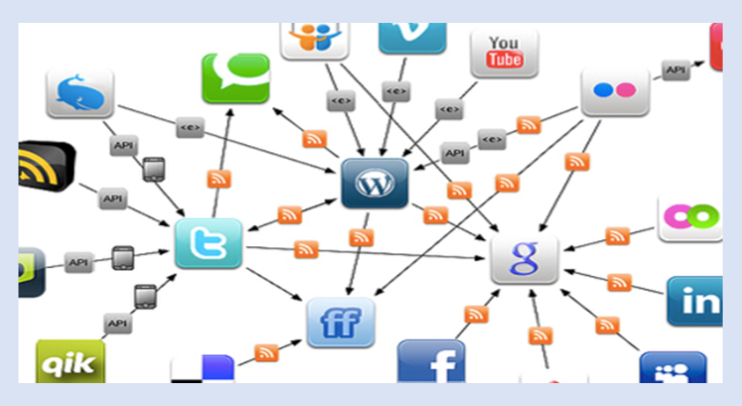
Networked Life: Project
18/01/2022

Slide 2
Project Goal
Introduce new algorithms and techniques to provide custom recommendations to users based on what other users liked
Learn some basic skills and gain practice experience in machine learning, and enrich your resume

Slide 3
Main Tasks
Part 1 Linear regression on Netflix dataset
Expand on the homework Q4 (i.e., linear regression) by reusing your written code previously, applying it to the Netflix training dataset
Part 2 Restricted Boltzmann Machines (RMB)
Develop a classic neural network model to predict a user’s rating: restricted Boltzmann machines (RBM)
Part 3 Extensions to the RBM model
Build extensions to the RBM model using some hints we give you and any information you can find online

Slide 4
Part 1
Linear regression on Netflix dataset
Expand on the homework Q4 (i.e., linear regression) by reusing your written code previously, applying it to the Netflix training dataset

Slide 5
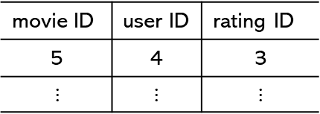
Dataset
Part 1:Linear regression on Netflix dataset
Two datasets in the folder (code):
training.csv: imported to a matrix by getTrainingData function in projectLib file.
validation.csv: imported to a matrix by getValidationData function in projectLib file.
training set
validation
set
test
set
e.g.
hidden
movie ID | user ID | rating ID
5 | 4 | 3
$⋮$ | $$⋮$$ | $$⋮$$

Slide 6
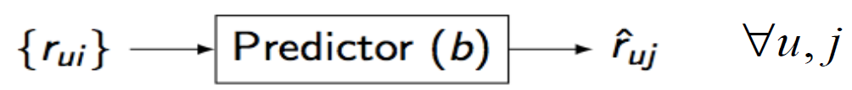
Question 1.1
Part 1:Linear regression on Netflix dataset
Finish the parameter estimation param function to compute the baseline estimator for the training set, without regularization
Finish the predict function to compute the predicted rating of every (movie, user) pair of the training set
Then you can compute the RMSE to compare the two

Slide 7
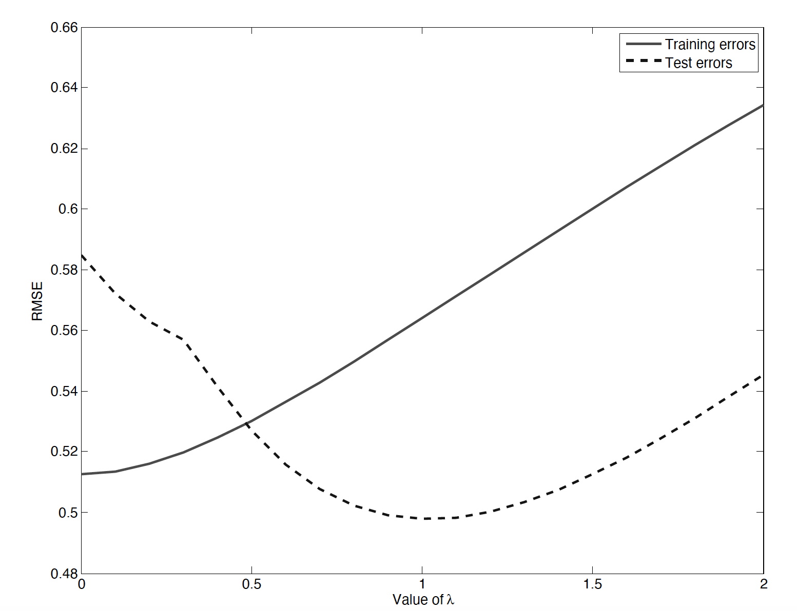
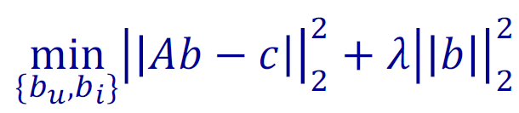

Question 1.2
Part 1:Linear regression on Netflix dataset
Regularize this model so that it does not overfit, by adding a penalty to your biases. You should now complete the param_reg function.
Find the optimal $λ$

Slide 8

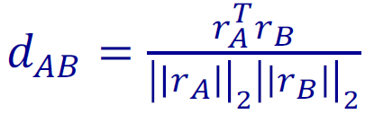
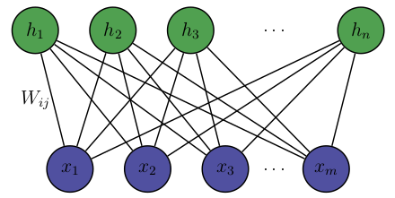
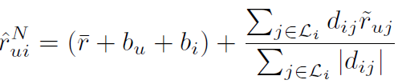
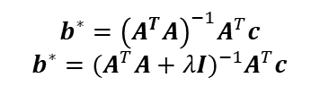
Review
Baseline
Predictor
Restricted Boltzmann Machines (RBM)
Neighborhood
Predictor
$$b^{∗}={\left(A^{T}A\right)}^{−1}A^{T}c$$
$$b^{∗}={(A^{T}A+λΙ)}^{−1}A^{T}c$$
Interactions among movies and users
Linear Regression
undirected graphical model

Slide 9
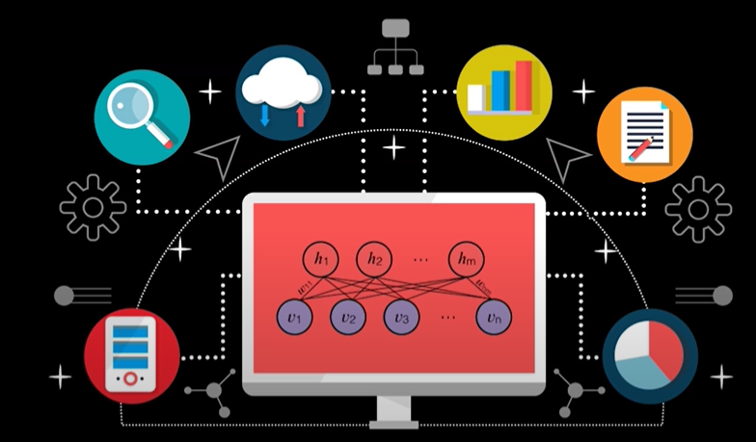
Part 2
Restricted Boltzmann Machines
(RBM)
rbm.py, mainRBM.py

Slide 10
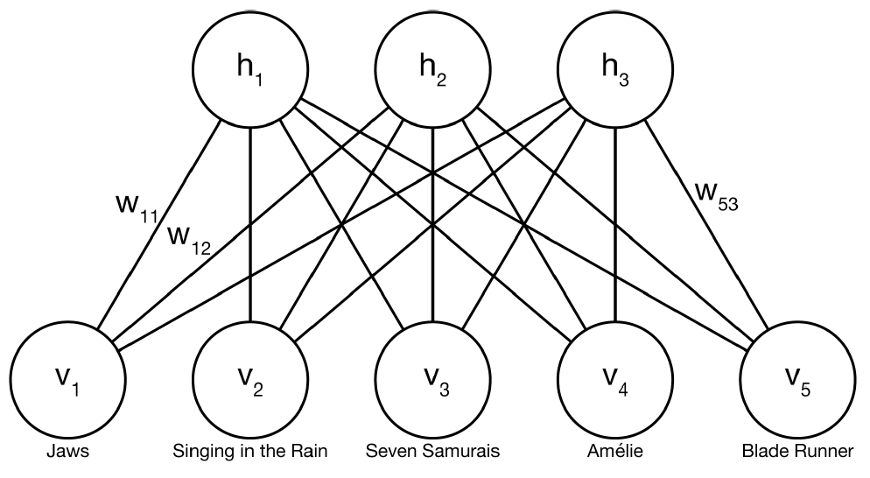
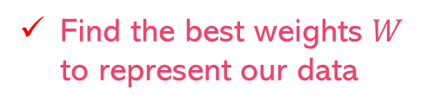

RMB model
Part 2: Restricted Boltzmann Machines (RBM)
Visible layer V
Each node is corresponding to a movie
Receives input (e.g., user’s ratings)
Hidden layer H
Each node represents a feature (e.g., whether user likes action movie or not)
action
drama
Sci-fi
hidden layer
$v_{i}$,$h_{j}$ are binary, i.e. {0,1}
Find the best weights $W$ to represent our data
visible layer
input: rating

Slide 11
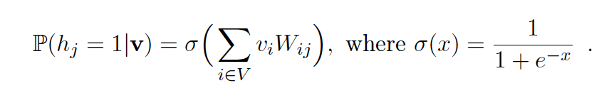
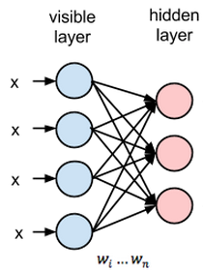

Question 2.1
Part 2: Restricted Boltzmann Machines (RBM)
When visible layer receives input, the input is transformed to the hidden layer and passed through an activation function to produce the node’s output:
the probability of feature j to be active.
In the rbm.py file, complete the function sig.

Slide 12
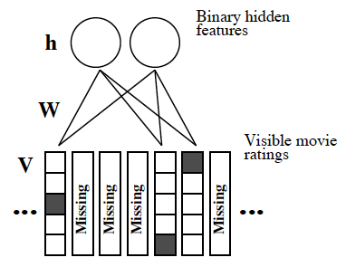
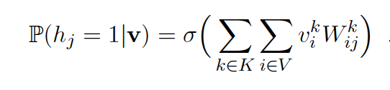
Question 2.2
Part 2: Restricted Boltzmann Machines (RBM)
RBM requires the input data to be binary form. To adapt to the requirement, we encode each rating as a binary vector
The rating from a user can be one of the five options, K = {1, 2, 3, 4, 5}
If a user gives a rating 3, that piece of data will be encoded by the vector (0, 0, 1, 0, 0)
From visible states to the hidden ones:
Write a function to propagate the visible input (binary vectors of ratings) to the hidden layer, in visibleToHiddenVec

Slide 13
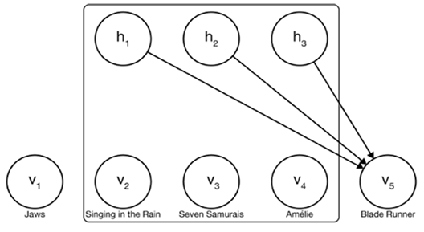

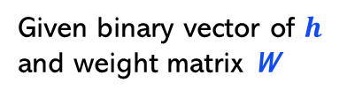
Question 2.3
Part 2: Restricted Boltzmann Machines (RBM)
After we compute the probability of features (hidden nodes), we then compute the predicted results of the user from hidden nodes to visible nodes
Given binary vector of $h$
and weight matrix W
Hidden activations flow down to give a distribution over the ratings
$$v_{i}$$
Implement the hiddenToVisible function, taking as input a binary vector of hidden units and the edge weights.

Slide 14
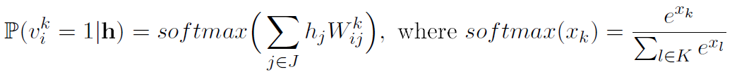
Question 2.4
Part 2: Restricted Boltzmann Machines (RBM)
Implement the function getPredictedDistribution to get the predicted distribution over the ratings for a movie
e.g. $P_{i}$= (0.1, 0.2, 0.4, 0.3, 0), the probability that rating = 3 is 0.4
K = {1, 2, 3, 4, 5}
Output is a distribution over all the possible K states, i.e., the probability that each of the K binary variables takes the value 1
We need to transform the probability distribution of user’s rating at different scores to a standard rating

Slide 15
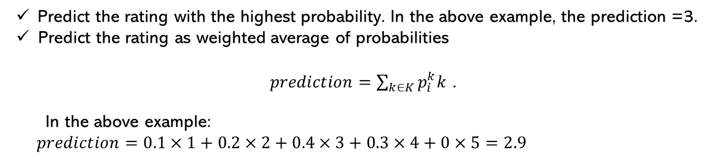
Question 2.5
Part 2: Restricted Boltzmann Machines (RBM)
Implement the two functions predictRatingMax and predictRatingExp, which implement the two options below
e.g., A user’s probabilities for a movie $i$ at 5 different score options:
$P_{i}$= (0.1, 0.2, 0.4, 0.3, 0), the probability that rating = 3 is 0.4
K = {1, 2, 3, 4, 5}
Predict the rating with the highest probability. In the above example, the prediction =3.
Predict the rating as weighted average of probabilities
$prediction=\sum_{k∈K}{p_{i}^{k}k}$ .
In the above example:
$prediction=0.1×1+0.2×2+0.4×3+0.3×4+0×5=2.9$

Slide 16






Find weights
Part 2: Restricted Boltzmann Machines (RBM)
RBM
${\{r}_{ui}$}
predictor
$$W$$
{${\hat{r}}_{ui}$}
Find the weights that maximize the probability that our model would generate the data it has been trained on, which is called log-likelihood $max log⁡P(v)$
Use a gradient ascent method.
Start from a random weight
Update weights by adding the gradient

Slide 17
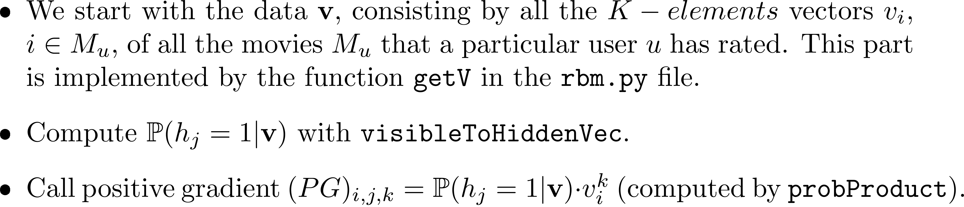
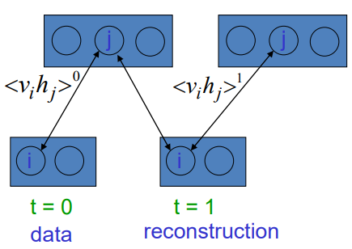
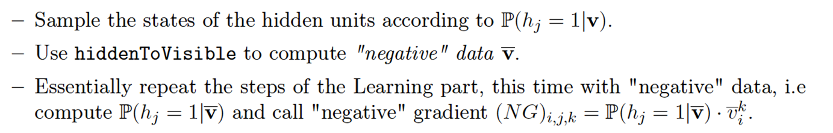
Gradient ascent method
Part 2: Restricted Boltzmann Machines (RBM)
Learning
…
Unlearning:

Slide 18



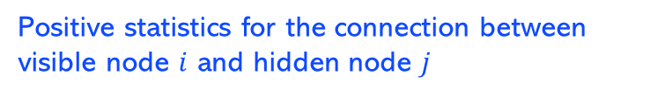
Gradient ascent method
Part 2: Restricted Boltzmann Machines (RBM)
Synthesis: Update only the weights for the movies that the user has rated.
Negative statistics
where
Positive statistics for the connection between visible node $i$ and hidden node $j$

Slide 19
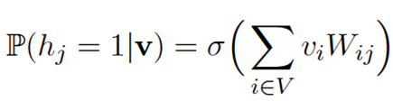





RMB model
Part 2: Restricted Boltzmann Machines (RBM)
hidden layer
activation function
$$W$$
Binary vector $v_{i}$
Distribution over rating
Max/Exp
input: rating
rating
visible layer
Gradient ascent method
predictor
{$\hat{v}$}
{$v$}
$$W$$
max log𝑃(𝐯)

Slide 20
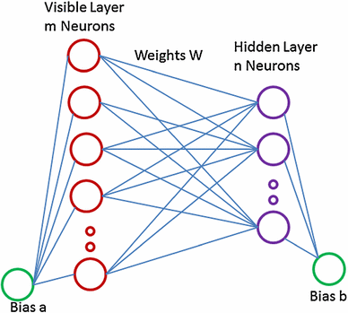
Part 3
Some extensions by online references
Momentum
Adaptive learning rates
Early stopping
Regularization
Mini Batch
Biases

Slide 21
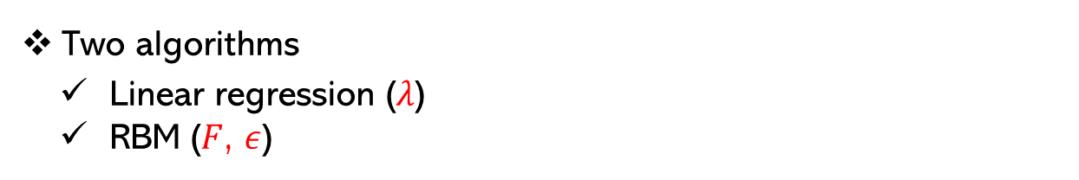
Your algorithms
Two algorithms
Linear regression ($λ$)
RBM ($F$, $ε$)
It is important to train your model on the training set, and then see how well it performs on previously unseen data contained in the validation set
You can change the hyperparameters to make the algorithms more performant

Slide 22
Test data
Test your program on test data (test.csv)
When you produce the rating file (for all movies and for all users), name it in the following format: <Group ID>_v<version number>.txt
After receiving your file, we will compute the RMSE obtained on the test set and give you its value
training set
validation
set
test
set
hidden

Slide 23
Bonus
Competition for bonus score
Submit result once every week from week 10 to week 13
(Based on RBM, not Regression)
At the end of each week, the current best RMSE (over all previous weeks) will be broadcasted to the class, for you to know which is the current goal to beat. Also, each week, the team with the best outstanding RMSE over the test set will get a bonus of 5 points
At most 10-bonus score for each group
Week | Dates
10 | Monday, April 4 - Sunday, April 10 (11:59 PM)
11 | Monday, April 11 - Sunday, April 17 (11:59 PM)
12 | Monday, April 18 - Sunday, April 24 (11:59 PM)
13 | Monday, April 25 - Sunday, May 1 (11:59 PM)

Slide 24
Submission and Grading
Project Group: Same with homework group.
Submission: Source code + Report (Deadline: Week13)
Grading:
(25%) Part 1: Linear regression (linearRegression.py, projectLib.py)
(25%) Part 2: Basic RBM (rbm.py, mainRBM.py)
(25%) Part 3: Extensions of the RBM
(25%) Part 4: Report
5 bonus points for the group submitting the best results each week
10 bonus points for the best results overall

Slide 25
Thanks!
Do you have any questions?

